Slide 1
MCDA 5550 - Web App Development Chapter 02: HTML5 - editors, file transfer
Instructor: DINESH KG

Slide 2
HTML
Hypertext Markup Language - ".htm" and ".html“ Browsers do not display the HTML tags, but use them to interpret the content of the page.
Consists of tags
Instructions to the web browser how to display and behave
<html>
<head>
</head>
<body>
</body>
</html>

Slide 3
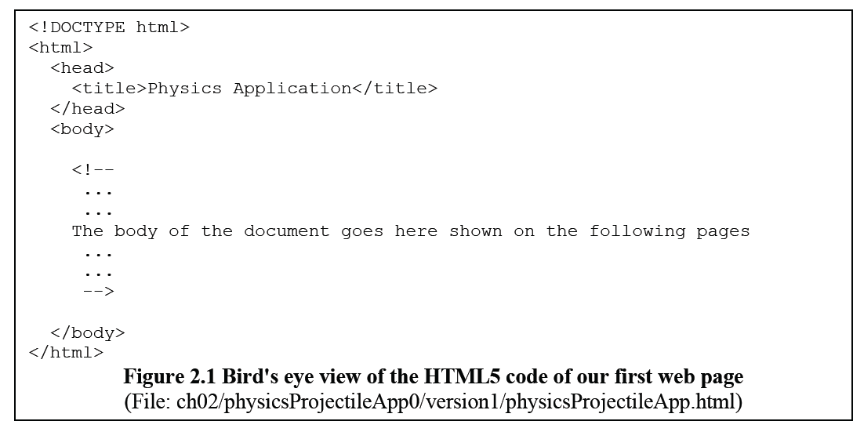
Typical HTML structure

Slide 4
Basic HTML tags
<!DOCTYPE html> (no closing tag!)
must be the very first line in your HTML document, before the <html> tag
It’s not an HTML tag; it is an instruction (declaration) to the web browser about what version of HTML the page is written in.
Many different types (versions), but we’ll use
<!DOCTYPE html> (i.e., HTML5)
(http://www.w3schools.com/tags/tag_doctype.asp )

Slide 5
HTML tags (cont’d)
<html> HTML documents </html>
<head>Other tags to set up the web page
Such as <title>Title of the page</title>
</head>
<body>Actual text to be shown
<p>A paragraph</p>
<h1>top-level header</h1>
<h2>2nd level header</h2>
<br> line break (no closing tags)
</body>
Lots more!!!

Slide 6
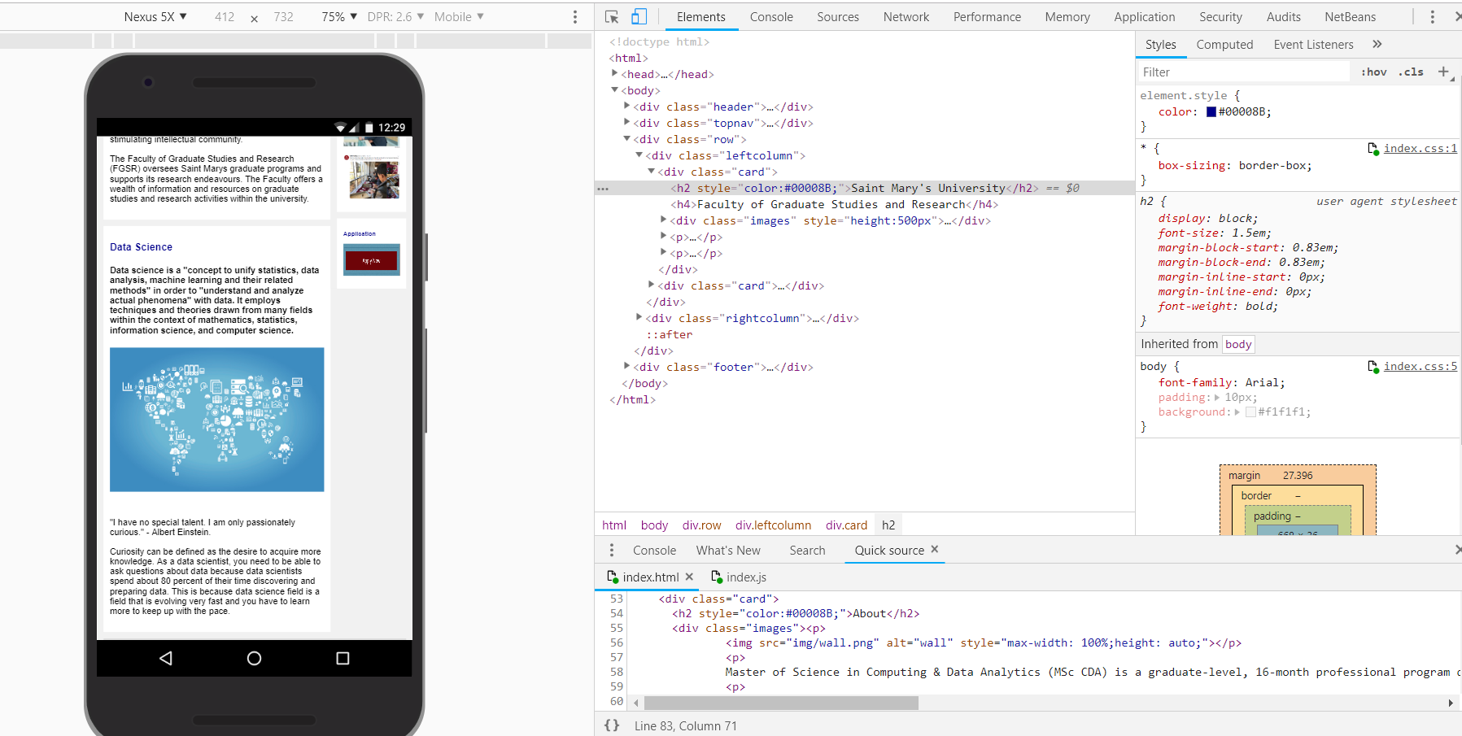
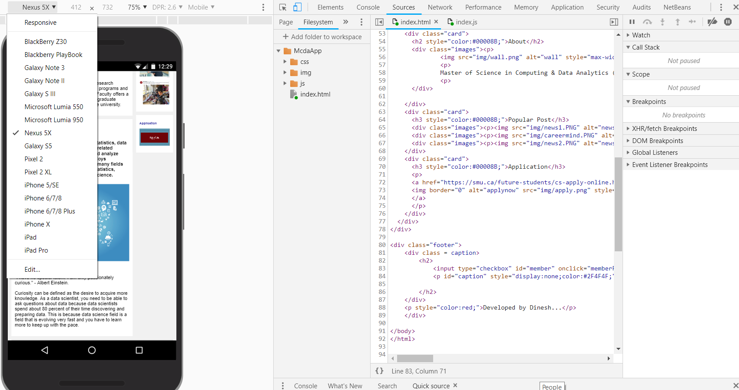
Chrome dev tools

Slide 7

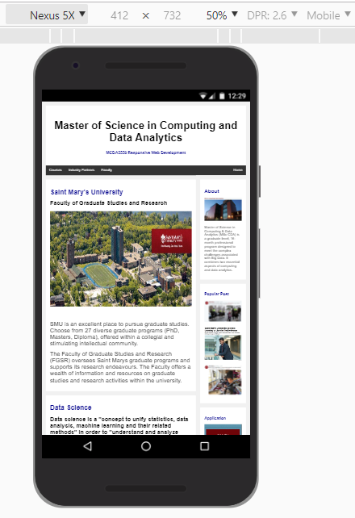

Choose a device!

Slide 8
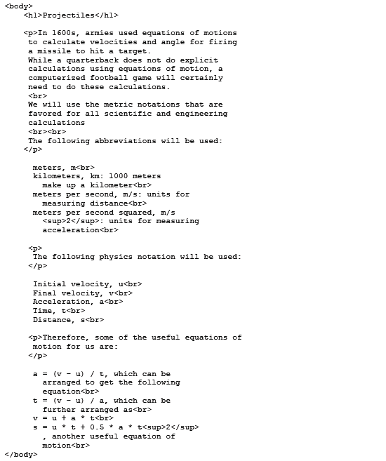
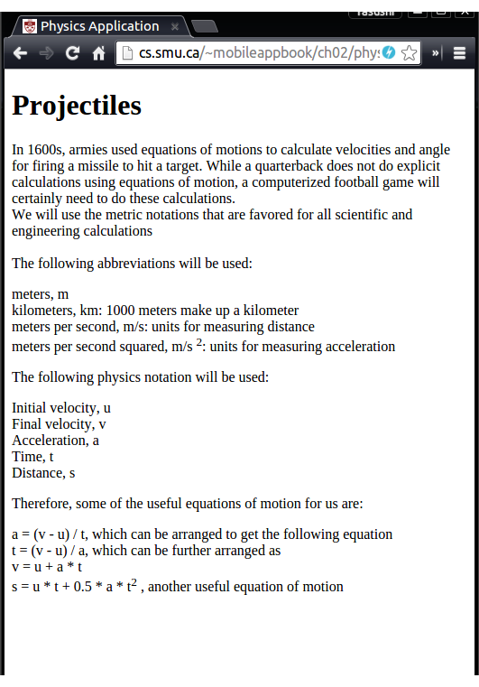

Slide 9

Cont’d
Format is essentially done by tags, but not by the text formatting of HTML
E.g.) Adding a simple new-line in HTML doesn’t add a new line on the web page
<p>
<br>

Slide 10
More text formatting
<ul> Unordered list (bullets)
<ol> Ordered list (numbered)
<table>
<tr> rows
<th> table header columns
<td> (regular) columns

Slide 11


Add more formatting info
style attribute of a tag:

Slide 12
CSS
Cascading Style Sheets
Separately stored formatting info
Allow central control, instead of individual formatting

Slide 13
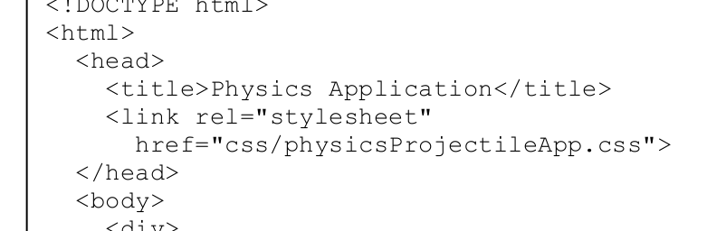
<link> tag
used to define relationship between an HTML5 document and an external resource.

Slide 14
CSS syntax
tag childTag … {
attribute1: value1;
attribute2: value2;
// etc
}
Don’t forget ; (semicolon) at the end of each line
body
{
background-color: #78BDFA;
font-family: Arial;
}
h1
{
text-align: center;
}
table
{
background-color:#444444;
color: white;
border-radius: 25px;
text-align: center;
}
table tr td
{
padding: 5px;
}

Slide 15
CSS colors
Predefined (http://www.w3schools.com/cssref/css_colornames.asp):
#p1 {background-color: red;}
Hex:
#p1 {background-color: #ff0000;}
RGB:
#p1 {background-color: rgb(255, 0, 0);}
RGBA:
#p1 {background-color: rgba(255, 0, 0, 0.3);}
Also others (HSL, HSLA)

Slide 16
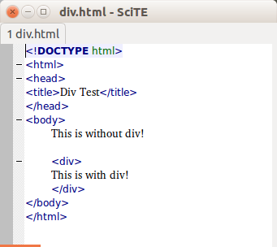
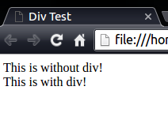
<div> tag
Does not have any associated semantic.
Often used for grouping a block of HTML5 elements to format them with CSS3.

Slide 17
id attributes
Each HTML element can have a unique id
An id can be used to access the element from the CSS specifications as well as JavaScript (via the HTML DOM), similarly to variable names in object-oriented languages

Slide 18
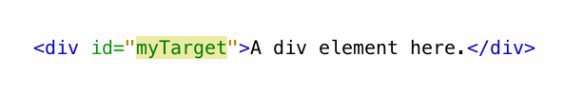
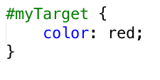
id attributes (cont’d)
In HTML
In CSS (note the use of #)

Slide 19
class attributes
Similar to id, but used for a group of elements.
Each id is unique, and CSS specs for the id is applied to that particular (single) element
CSS specs for a class are applied all the elements with the same class name

Slide 20

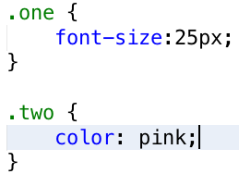
class attributes (cont’d)
In HTML:
In CSS:

Slide 21
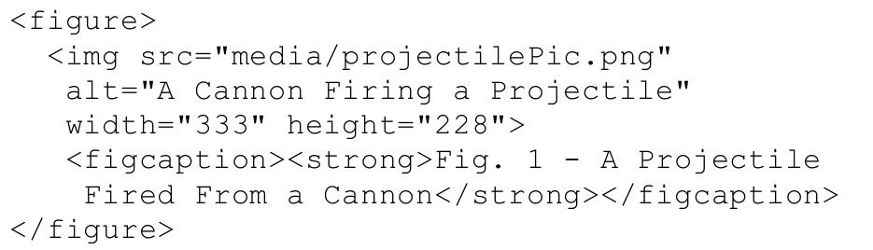
Multimedia content
<figure> tag – new in HTML5
Encloses components of figures (img, figcaption)

Slide 22
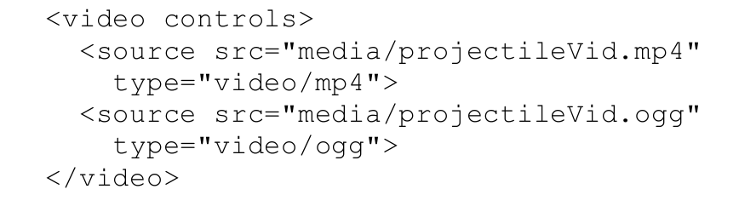
Multimedia content
<video controls>

Slide 23
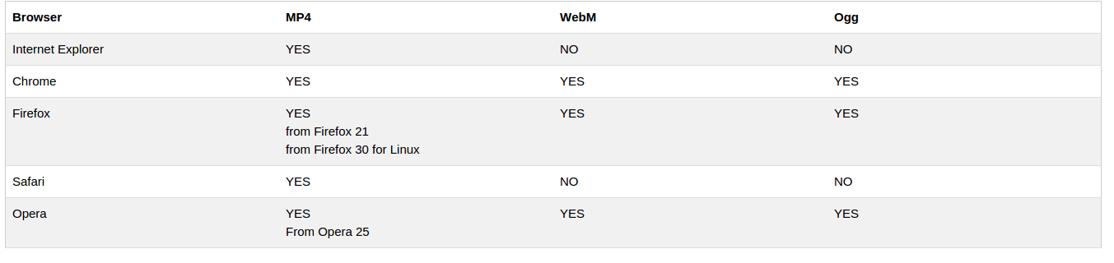
Video formats

Slide 24
Accessing the Web server
Your account is created on a server (dev.cs.smu.ca)
Transfer files:
ftp – file transfer protocol
sftp – SSH (secure shell) ftp
scp – secure copy

Slide 25
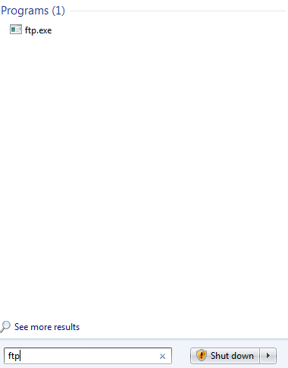
ftp
Windows default ftp:
Run (windows key + r)
type ftp
But!! Doesn’t work on dev.cs.smu.ca
Insecure connections not allowed

Slide 26
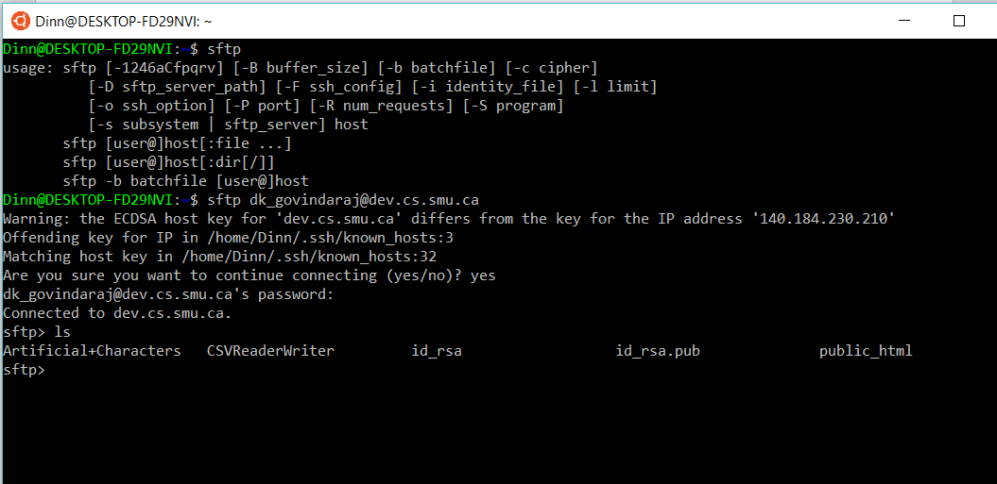
sftp
Was not provided by default in Windows before. But now it is!
Available in Linux and OS X (at least in terminals) Same command

Slide 27
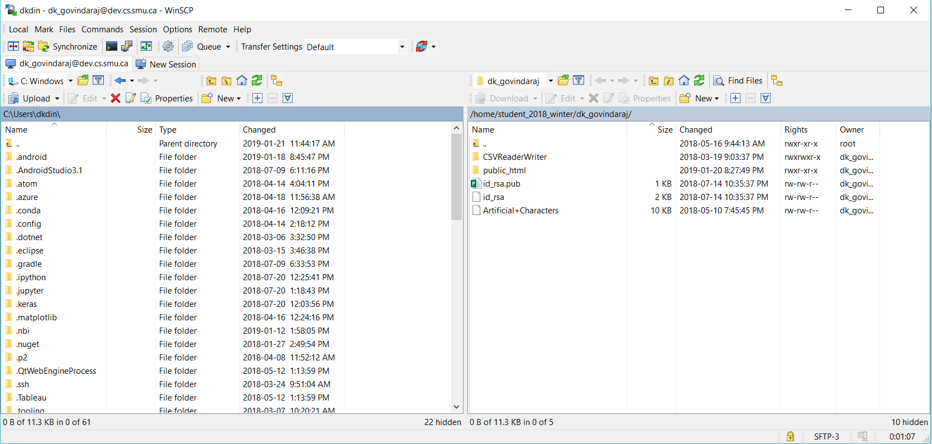
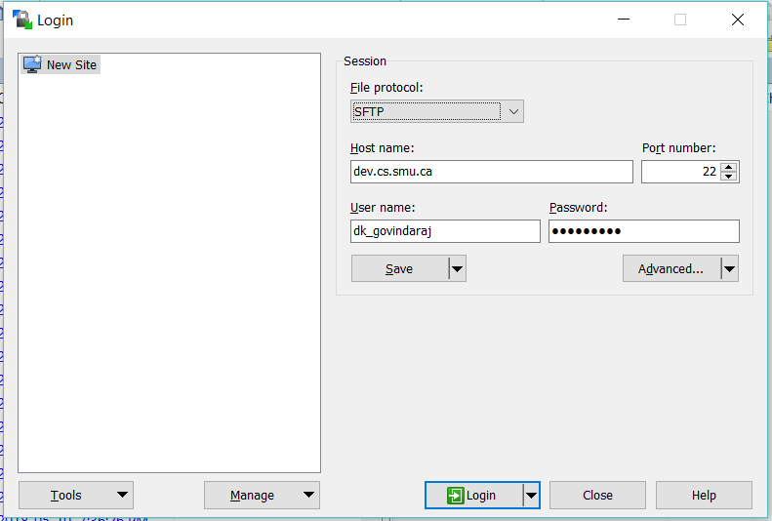
GUI version (Win)
Win SCP: https://winscp.net/eng/index.php

Slide 28
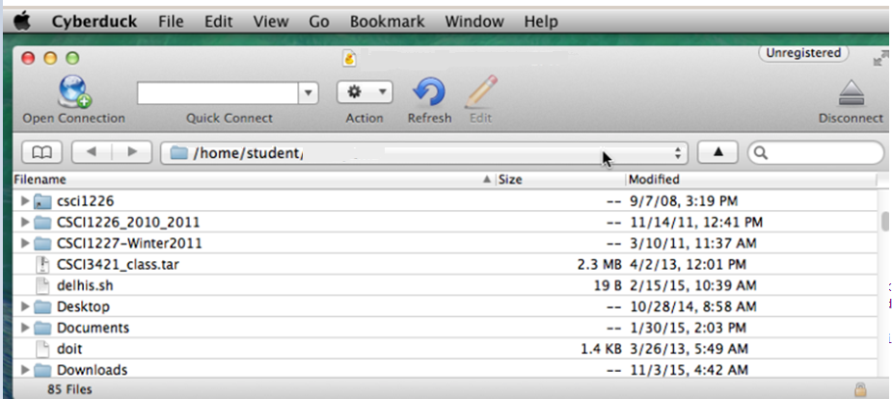
GUI version (Mac/Win)
Cyberduck: https://cyberduck.io/?l=en

Slide 29
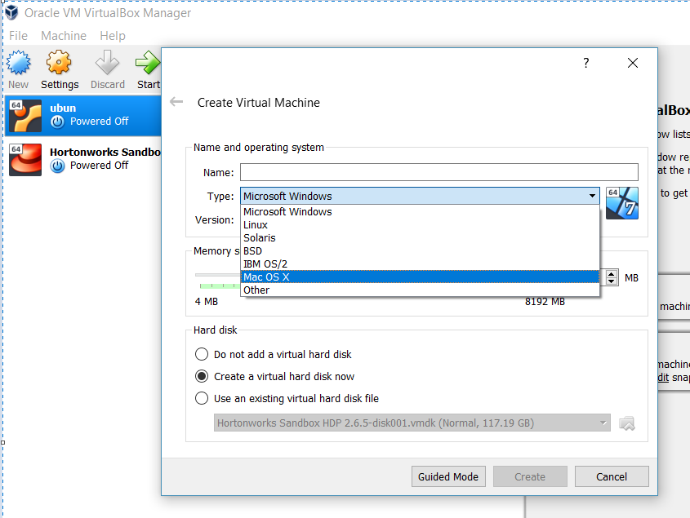
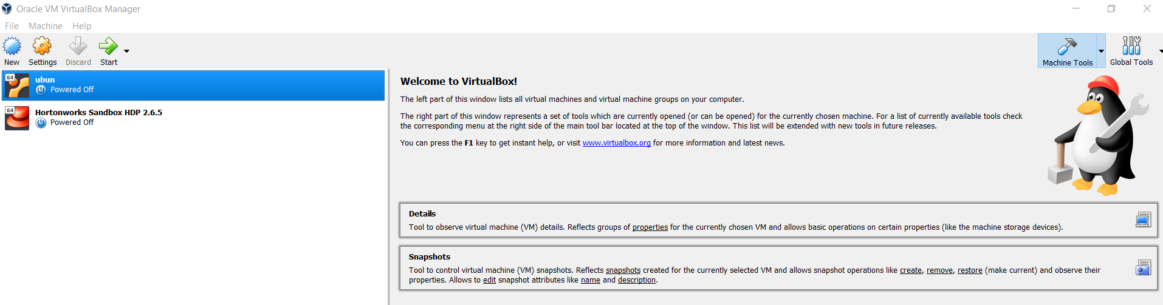
Virtual Computers

Slide 30
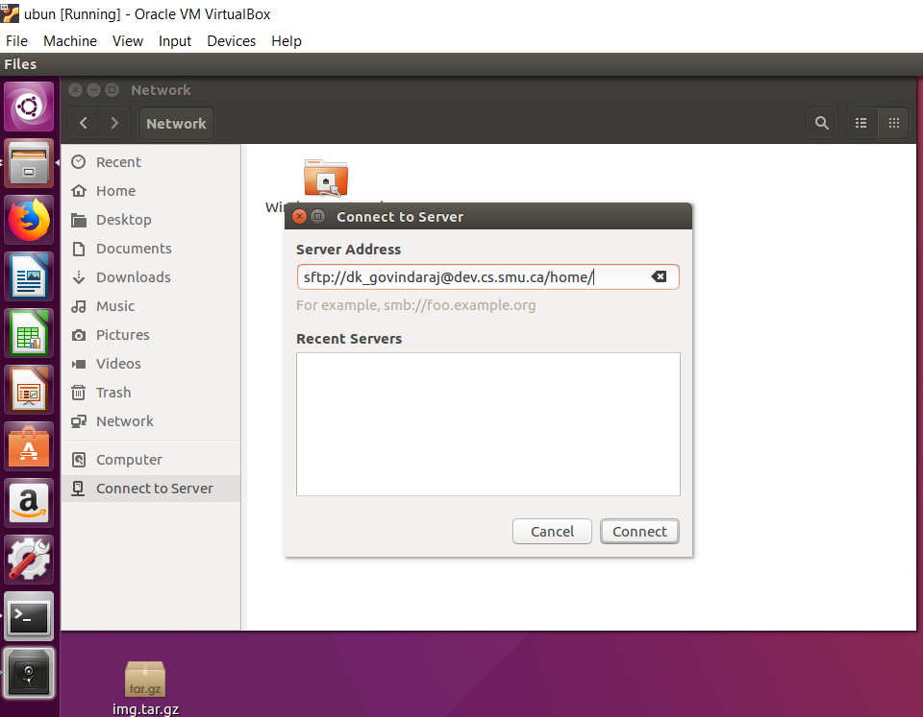
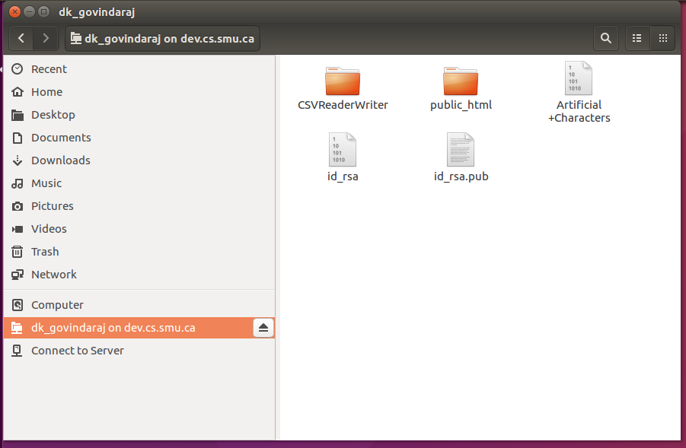
GUI version (Linux)
Built-in

Slide 31
Folder structure
Home directory
public_html directory
This folder is (associated with) our web directory on the server
Upload files to this directory!

Slide 32
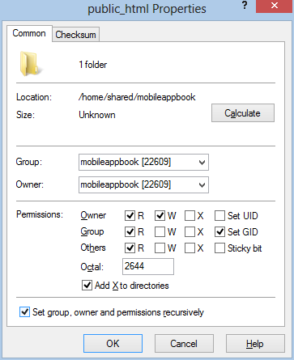
File/Folder permissions
Need to control who can read/write/execute

Slide 33
Or in terminals
chmod 775 /path/to/file
0 – no permission
1 – execute
2 – write
3 – write and execute
4 – read
5 – read and execute
6 – read and write
7 – read, write, and execute
chmod u+r+w+x,g+r+x-w,o+r+x-w /path/to/file
u – user
g – group
o – other (world) ⬅ this is typically the case for the audience using browsers
r – read
w- write
x – execute

Slide 34
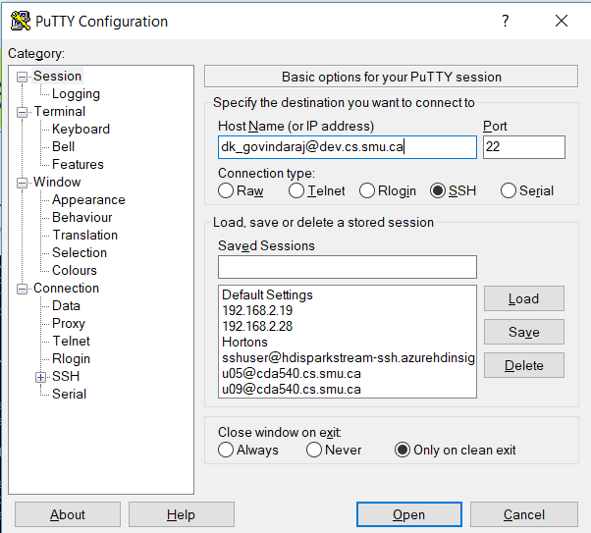
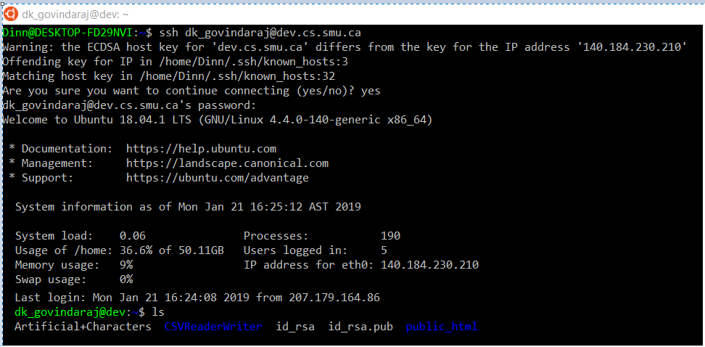
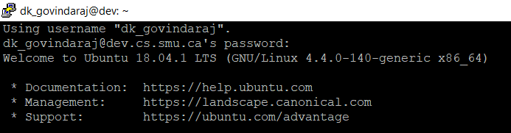
Secure shell
ssh on Linux or Mac
putty (and others) on Windows

Slide 35
Basic Linux commands
ls list files/directories cd change directory
cd ../ change to the parent directory
mkdir make a new directory
cp/cp -r copy files/directories
vi/nano open files
cat display text files
chmod change permissions

Slide 36
Editors
Any text editors will work
Notepad (Win), TextEdit (Mac), gedit (Linux)
Most standard programming IDEs
NetBeans, Eclipse, MS Visual Studio, TextPad
Dedicated HTML/CSS editors
Brackets, BlueFish (text based)
Dreamweaver, Google Web Designer (WYSIWYG)

Slide 37
Class Activity
Create a simple html, CSS, JS.
a click me button in html
onclick function in JavaScript
display Your full name and A# in any color (use CSS for color)
Place the project on server. (only under your id on server)
Access the same from your local.
http://dev.cs.smu.ca/~yourServerId/name.html

